Slide 1

BLOOD BANK DATABASE MINI-PROJECT
Group :
Nguyen Thi Hong Anh
Nguyen Viet Hoang
Nguyen Tri Hung
Nguyen Manh Phuc

Slide 2
Contents
Ideas
Database Design
Application Creation
User Guide

Slide 3

❶ Ideas
The needs for blood for medication are always high. However, hospitals are usually lack of blood.
There are a lot of people (mostly youngsters) who are willing to donate blood.

Slide 4
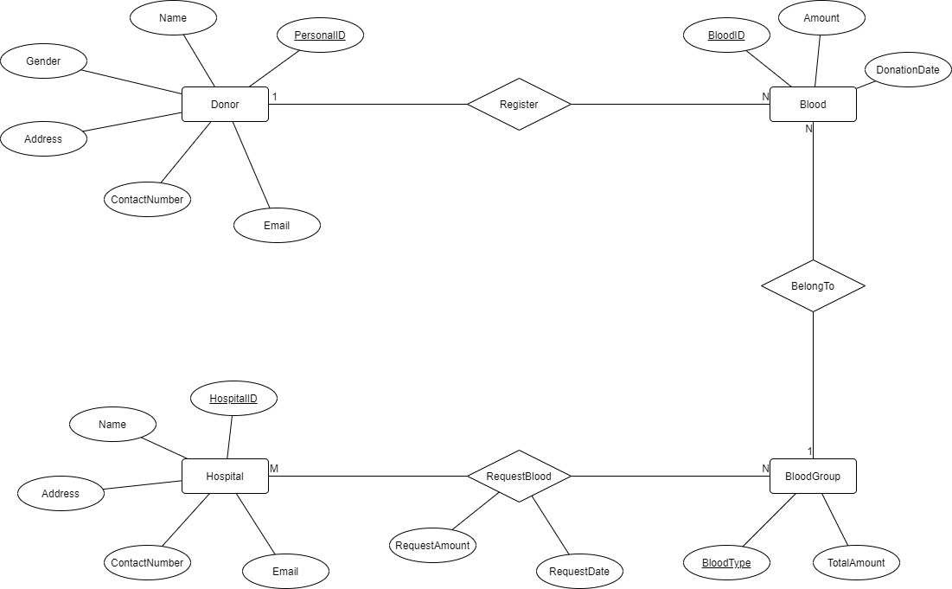
❷ Database Design

Slide 5
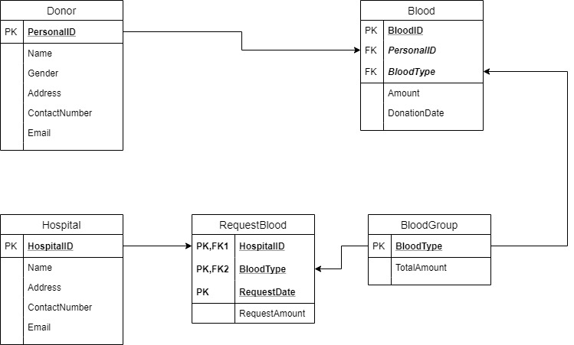
❷ Database Design

Slide 6
❸ Application Creation
Web application.
Database: Managed with PostgreSQL.
Server building and implementation: Designed with Python.

Slide 7
❸ Application Creation
Create tables: Donor, Blood, BloodGroup, Hospital, RequestBloodHistory.
Add new donor registers to Donor and Blood tables. If the donor exists in the Donor table, check whether that register is valid (new donation should be more than 3 months after the last one).
Add new hospitals’ requests for blood to RequestBloodHistory (if the hospital is new, add it to Hospital table). Check whether the requested blood type has enough amount.
Show the statistics of the blood amount in the bank from the BloodGroup table.
Database Management

Slide 8
❹ User Guide
What you can do with our blood application ☺

Slide 9
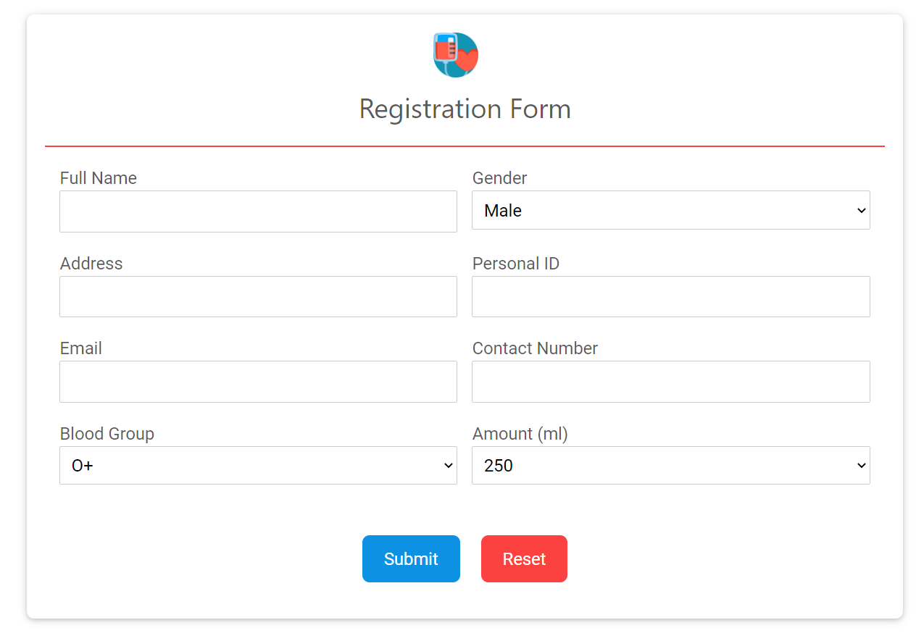
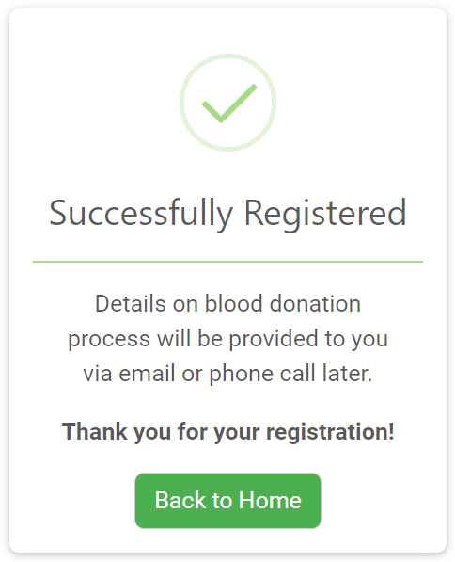
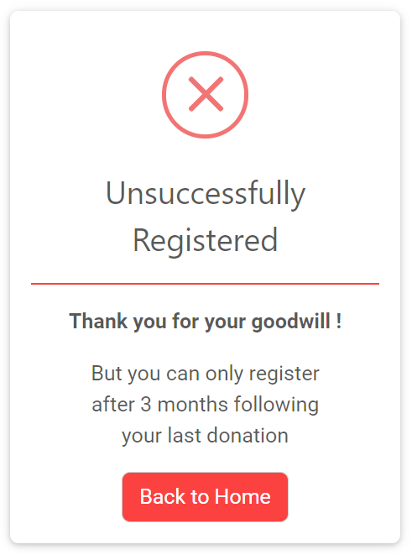
❹ User Guide
Blood Donate Registration
User fills in the form with the corresponding information.
Press “Submit” to register (it’ll send data to server).
If the donation is valid, it will return a “register-success” page. Else, there would be a notification page shown.

Slide 10
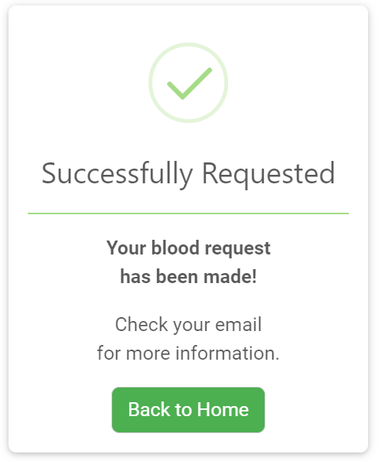
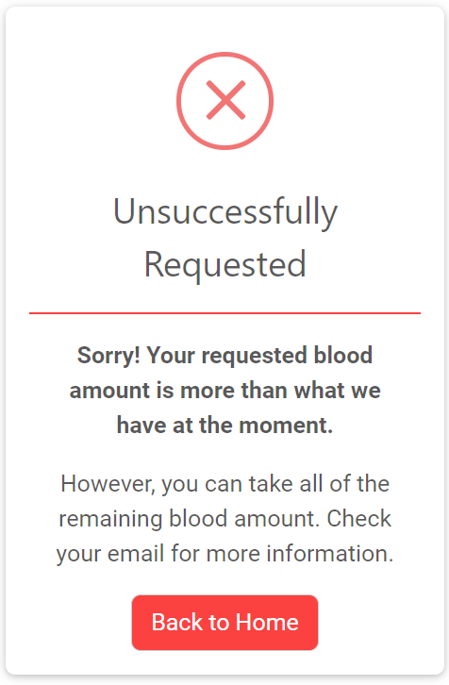
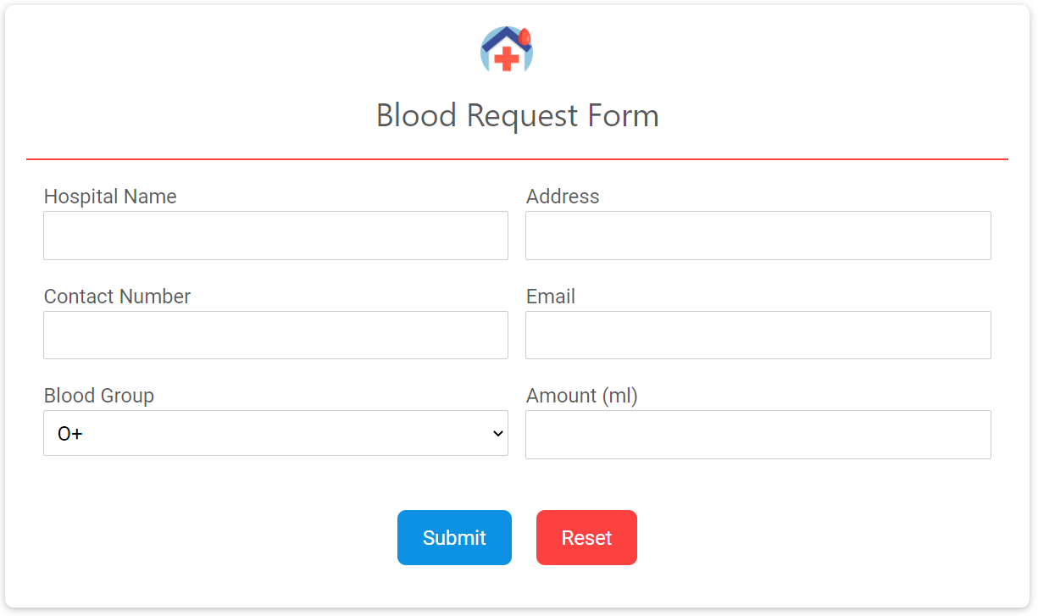
❹ User Guide
Blood Request for Hospital
User fills in the form with the corresponding information.
Press “Submit” to send the request.
If the request is valid, it will return a “request-success” page. Else, there would be a notification page shown.

Slide 11
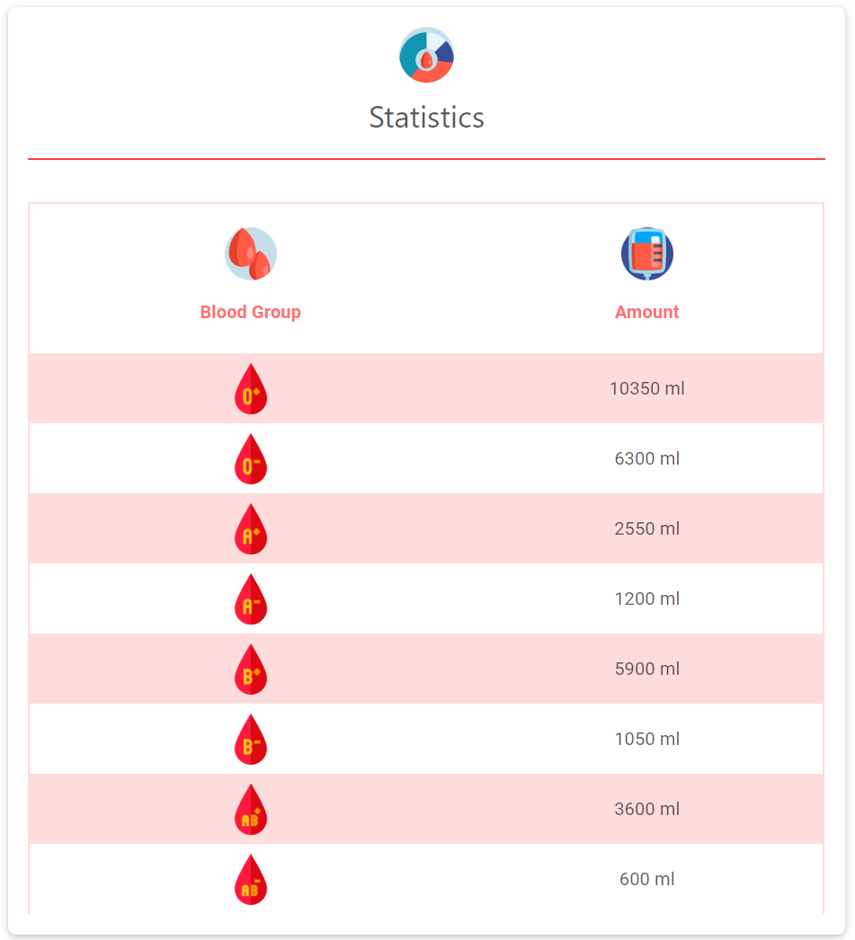
❹ User Guide
Statistics
This page shows the current amount of each blood group in the bank.
It would be very useful for hospitals to determine the blood amount they can request.

Slide 12
Blood bank database mini-project
Thank you
from Group❹

